Slide 1
Dot to Dot and Beyond
Graphs and Networks
Graph Theory
rob_money22@yahoo.com.au
jwidmer@scitech.net.au

Slide 2
The ‘Space’ Curriculum
What to ditch? – move?
Graphs and networks are now in VCAA Maths v2.0 Year 10
and in VCE General Maths and Specialist Maths.
Is ‘graphs and networks’ curriculum appropriate to earlier year levels?
Do we still need congruence axioms, angles on parallels, angles in a circle?
What content best meets student needs and interests?

Slide 3
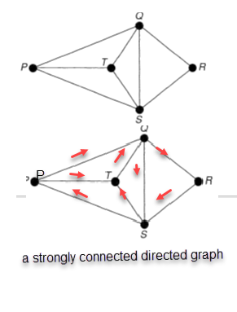
Year 6+ Simple Graphs Complete Graphs have no multiple edges have all possible edges
Five people are playing in a chess tournament.
What matches have yet to be played?
The complete graph on n vertices has n(n – 1)/2 edges.
Who can claim to be the best player? Everyone!
What other simple graphs would interest students?

Slide 4
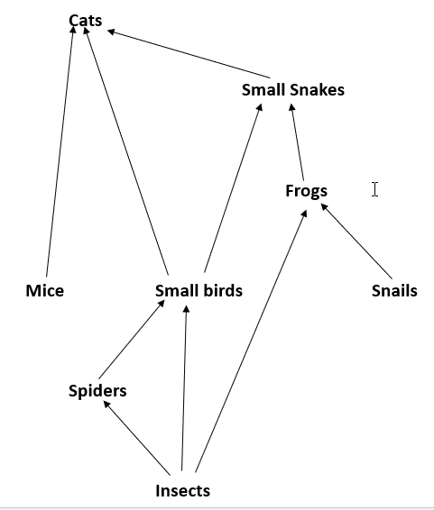
Year 7+ Directed Graphs
Each edge has a direction
What is at the bottom of this food chain?
What does each directed edge mean?
Other directed graphs:-
older than, closer to school than
from other studies e.g. science

Slide 5
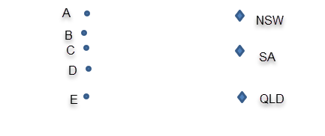
Year 7+ Bipartite Graphs
From ‘Source vertices’ to ‘Sink vertices’
Draw in 8 edges to represent the following.
Alby and Bet have visited all 3 states.
Charlie has visited NSW and SA.
Dannie has visited NSW and QLD.
Evie has visited just QLD.
What other bipartite graphs might students make? e.g students vs sports that they play.

Slide 6
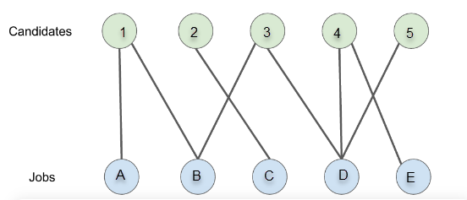
Year 8? Bipartite Graphs
Matching Problems
Can you remove edges until each candidate is matched with just one of the jobs?
Why was this originally called the ‘marriage’ problem?
What else could the candidates and jobs represent?
e.g. positions players can take.
books that students can talk about.

Slide 7
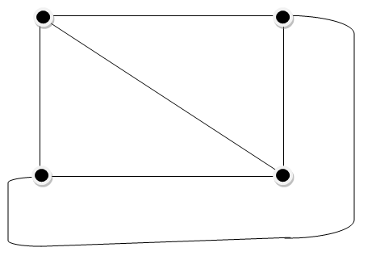

Year 8+ Planar Graphs no overlapping edges
The complete graph of 6 edges on 4 vertices can be drawn without the edges overlapping. K₄ is planar.
Can you draw all 10 edges on 5 vertices without edges overlapping?
No. K₅ is non-planar.
So is any graph
containing K₅.

Slide 8
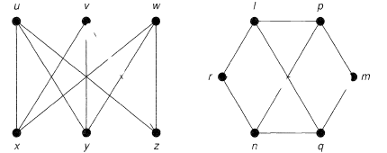
Year 8+ Which Graph is Planar?
Isomorphic graphs
Both! They are ‘the same graph’.
u - / v – m w – n
x – p y – q z - r.
These graphs are isomorphic and planar.
For no intersections redraw pn.
With one extra edge (vz or mr) we would have the complete bipartite graph K_{3,3}, which is non planar.
G is planar iff neither K_{3,3} nor K₅ is a subgraph, subdivision or minor of G.

Slide 9
Year 8+: Euler’s Rule and Map Colouring for planar graphs
Which part of the diagram represents the sixth face of the cube?
How many vertices, edges and faces?
To prove V + F = E + 2 by mathematical induction start with 1 + 1 = 0 + 2.
How many colours are needed here if adjacent faces need different colours?

Slide 10
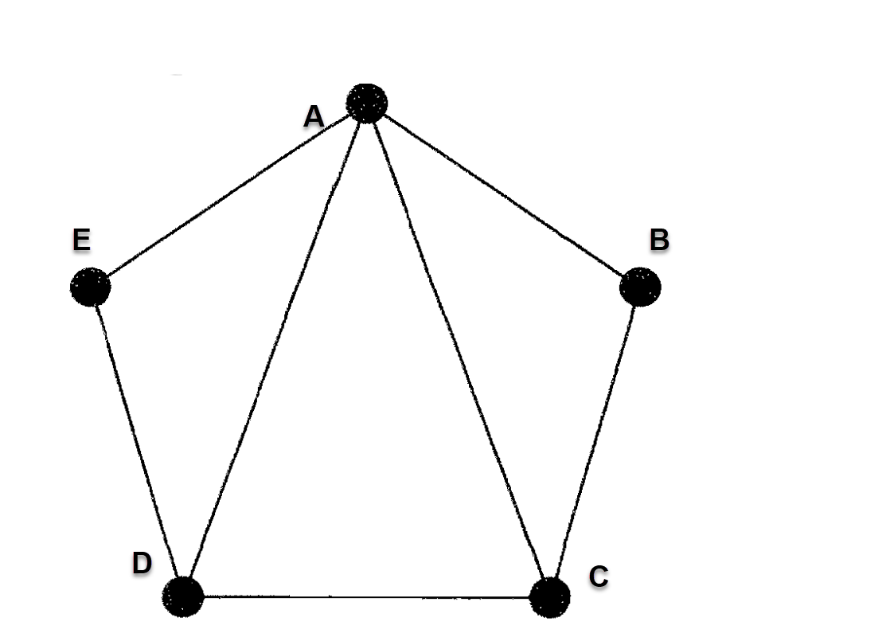
Year 9: Walks, Cycles, Trails & Paths
A walk is a sequence of edges that are either adjacent or identical, e.g. ABA (length 2) and ABCAB (length 4).
A cycle is a closed walk( last vertex = 1st) e.g. ABCDA
A trail has no repeated edges e.g. ABCADE
Semi Eulerian trail (all edges, once each) e.g. CBAEDACD
If edge CD was not there the graph would have the Eulerian trail ACBAEDA (also last vertex = 1st) .
A path has no repeated vertices e.g. ABCD
Semi Hamiltonian path (all vertices, once each) e.g. ABCDE
Hamiltonian path (also last vertex = 1st) e.g. ABCDEA

Slide 11
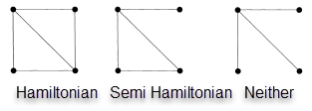
Year 9: Hamiltonian Graphs a cycle using each vertex just once
Knight’s Tour problems were the first Hamiltonian problems studied –Rudrata in the 9th century.
A simple graph on 3 or more vertices is Hamiltonian if:-
  deg(v) ≥ n/2 for all vertices
  or if deg(v) + deg(w) ≥ n for all non-adjacent pairs
The converses do NOT apply.

Slide 12


Eulerian Trails a cycle using each edge just once
An Eulerian trail exists in a graph with all vertices of even degree.
How many extra edges are required to eulerise this graph of a tetrahedron?
Is there an Eulerian trail on this graph of an octahedron?

Slide 13
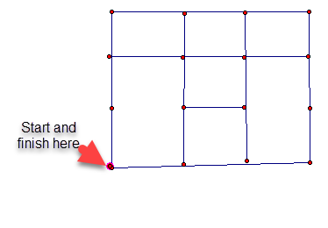
Year 9: Circuits Around Networks
Euler/Postie Trails and Hamilton Paths
How many of the 22 blocks does a bus need to cover twice as it goes all around this network?
How many blocks does the complete bus route take?
How many blocks for a garbage truck that needs to cover both sides of every road?
How many Hamilton circuits are there? (visiting each of the 16 vertices just once)

Slide 14
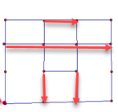
Circuits Around Networks Solution
These six blocks need to be covered twice.
The other 16 blocks can be covered by an Eulerian trail, so the bus route takes
6 x 2 + 16 = 28 blocks.
The garbage truck must also cover 16 blocks in the reverse direction –
a total of 28 + 16 = 44 blocks.
There are 3 Hamilton circuits here, each in clockwise or anti-clockwise directions.

Slide 15
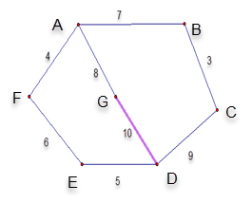
Year 9+: Trees
Trees contain no cycles
Find the minimum spanning tree for this diagram showing travelling times between cities.
A tree on 7 vertices has 6 edges. Choose the 6 shortest edges.
Which one or two cities might be best as distribution centres?

Slide 16

A Local Area Network Tree
Adapt for your home or school.

Slide 17
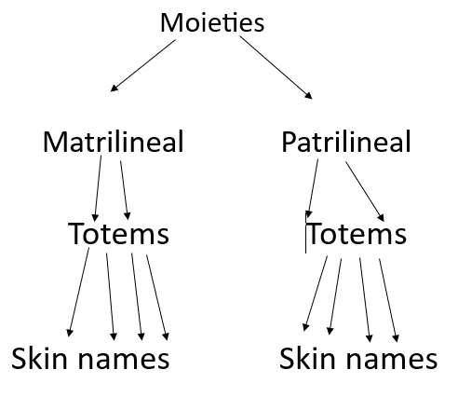
An Indigenous Kinship Tree?

Slide 18
Year 10: Weighted Graphs
The Postman and Travelling Salesman Problems
Find the shortest distance for A to visit the other cities and return home.
The postman can have repeat visits. The travelling salesman can’t.
.
distances | Home A | B | C | D | E | F
Home A | 0 | 136 | 63 | 111 | 45 | 99
B | 136 | 0 | 55 | 126 | 52 | 132
C | 63 | 55 | 0 | 42 | 69 | 56
D | 111 | 126 | 42 | 0 | 7 | 141
E | 45 | 52 | 69 | 7 | 0 | 6
F | 99 | 132 | 56 | 141 | 6 | 0

Slide 19
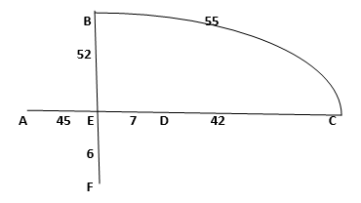
The Postman Problem
Using the minimum spanning tree
The graph shows the minimum spanning tree of length 152 plus the edge BC.
Route AEFEDCBEA uses AE and EF twice and visits E three times.
Its length is 258.

Slide 20
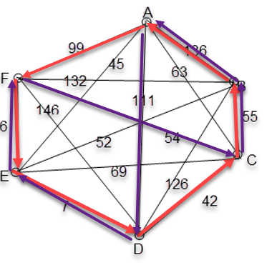
Travelling Salesman Solution
There are 60 Hamilton circuits that could be tested.
The minimum spanning tree to all vertices except E (214) plus the two shortest edges from E (13) gives 227, so the solution must be ≥ 227.
The nearest neighbour routes have length 369 starting from D and 345 starting from E.

Slide 21
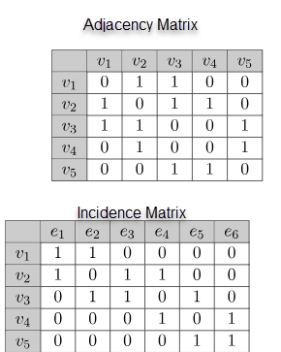
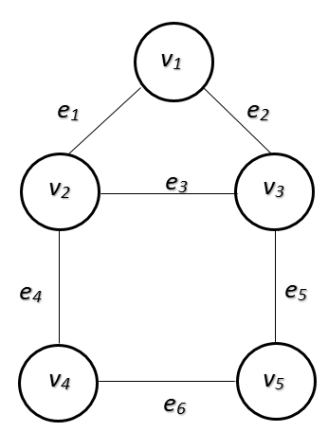
Year 10+ Adjacency and Incidence Matrices
The matrix product A^{n} gives how many walks of length n there are from vertex i to vertex j
The 1,1 element in A² is 2: 2 there and back walks.
The 2,4 element in A³ is 4: 4 walks of length 3.
The 1,4 element in A⁴ is 5: 5 walks of length 4.

Slide 22
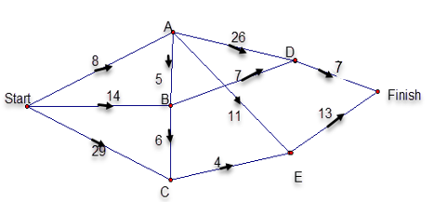
Year 10+: Weighted Directed Graphs
Shortest Path to D = 8 + 5 + 7 = 20
Longest path to D = 8 + 26 = 34
Critical Path: 29 + 4 + 13 = 46.
Slack time at D = (46-7) – 34 = 5
Maximum flow: minimum cut = 8 + 7 + 4 = 19

Slide 23
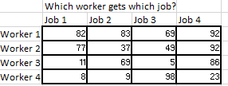
Year 10+ Allocation
We want one job for each worker at minimum overall cost.
There are 24 possible allocations here.

Slide 24
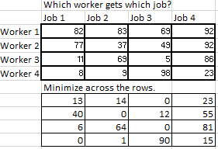
Year 10+ Allocation
By the Hungarian Algorithm

Slide 25
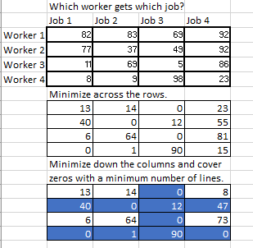
Year 10+ Allocation
. By the Hungarian Algorithm
Now solve by inspection – or go on.
6 is the minimum uncovered entry.

Slide 26
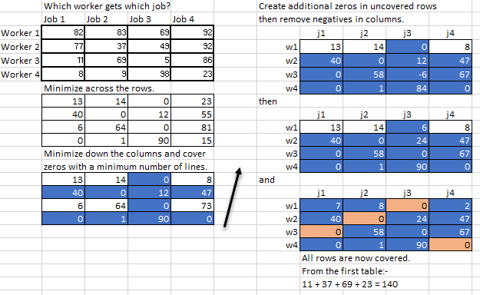
Year 10+ Allocation
By the Hungarian Algorithm

Slide 27
Summary – for Discussion
How much before Year 10?
              As presented here:- Maths v2.0 Level 10:-
Simple and Complete Graphs Year 6+? Interpret networks and
Directed Graphs Year 7+? network diagrams used to
Bipartite Graphs Year 7+? represent relationships in
Planar Graphs Year 8+? practical situations - and
Euler’s Rule for Planar Graphs Year 8+? describe connectedness.
Euler and Hamilton Circuits Year 9+? VCE:-
Trees Year 9+? All of this and more:-
Weighted Graphs Year 10? Proof in Specialist Maths.
Weighted Directed Graphs Year 10+?

Slide 28
Elaborations in Maths 2.0
recognising what real-world quantity(elements and connections) is represented by the vertices and the edges of a graph
investigating the use of graphs to represent a network, such as for the (Eulerian trail) Königsberg problem
investigating how polyhedrons may be represented as a (planar)network: Euler’s formula F + V = E + 2
investigating (tree?) diagrams for social networks, intranet, LAN, electrical wiring, wireless network of a home and practical problems involving connections, power overload or the need for routers
investigating the use of networks to represent authentic situations, for example travel; food webs; metabolic networks, chemical or biological structures and kinship systems

Slide 29
Some Teaching Resources
COMAP – USA - Consortium for Maths and its Applications
Mathigon - USA
Math Insight – UK
NRich – UK
Plus Maths – UK
The Wilson pdf – UK, for teachers https://www.maths.ed.ac.uk/papers/wilsongraph.pdf

Slide 30
The ‘Space’ Curriculum
What to ditch? – add? – move?
Student needs and interests?
Graphs and networks – but at which Year levels prior to VCE?
Congruence axioms? Angles on parallels? Angles in a circle? Euclidean proof?
Refs: John’s website for this powerpoint and our emails for further discussion
    Rob’s articles in Vinculum 1/2024 and 2/2024
rob_money22@yahoo.com.au
jwidmer@scitech.net.au

Slide 31
Direct Proof
Start with the given information and proceed by logical steps to the result required.
A regular graph of degree r on n vertices has ½ nr edges.
  Proof: Use the Handshaking lemma to justify the ½
2. There are ½ n(n-1) edges on a complete graph.
Proof: Each edge is joined to n – 1 other edges.
3. There are 2 ^{½ n(n-1)} labelled graphs on n vertices.
Proof: Each of the ½ n(n-1) edges is either there or not there.

Slide 32
Proof by Mathematical Induction
Euler’s Rule In a plane drawing of a connected planar graph V+ F = E + 2
Proof: Start with one vertex, for which 1 + 1 = 0 + 2.
Adding an edge requires the addition of either one more vertex or one more face.
If the degree of each vertex of a connected graph is even, then the graph is Eulerian.
The complete graph on n vertices has ½ n(n – 1) edges.
Every tree with n vertices has n – 1 edges.
A simple graph on 2n vertices containing no triangles has at most n² edges.

Slide 33
Proof by Contradiction
In any graph the number of vertices of odd degree is even.
  Proof: If the number was odd then the sum of all vertex degrees would be odd, which contradicts the handshaking algorithm.
If G is a simple graph with greater than n = 2 vertices, and if deg(v) + deg(w) ≥ n for each pair of non-adjacent vertices v and w, then G is Hamiltonian.
. Every simple planar graph contains a vertex of degree at most 5.
The K_{3,3} and K₅ graphs are non-planar.

Slide 34
Alkanes C₄H₁₀
In the isomers of propane each carbon atom has degree 4
n -butane and 2-methyl propane both have the formula C₄H₁₀
Crum-Brown 1864 Polya 1930
There are 2 trees with 4 vertices.

Slide 35
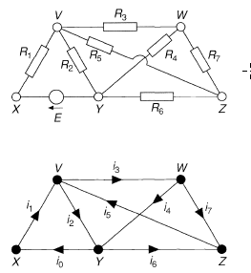
Electrical Circuits
Kirchoff 1845
Four cycle equations for:
VWZYXV, VWZV, VWZYV and WZYW
e.g. For VWZV, i₁R₁ + i₂R₂ = E
For VYZV, i₂R₂ + i₆R₆ + i₅R₅ = 0
Five vertex equations
e.g. For vertex V, i₁ + i₅ = i₂ + i₃

Slide 36
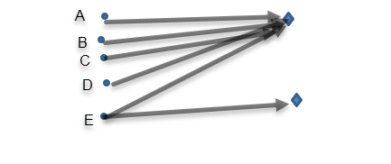
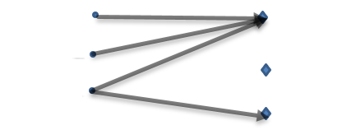
Bipartite Planar Graphs
Can you add the four remaining edges without overlapping?
Yes. The K_{5,2} graph is planar
Can you add the five remaining edges without overlapping? Can you install electricity, gas and water to a house without pipes overlapping?
No. The K_{3,3} graph is non planar

Slide 37
Regular Graphs
All vertices have the same degree
Petersen graph - degree d = 3,
V = 10 vertices and E = 15 edges.
Also the regular polyhedra:-
Cube – degree 3, V = 8 and E = 12
Tetrahedron – degree 3, V = 4 and E = 6
Dodecahedron – degree 3, V = 20, E = 30
Octahedron – degree 4, V = 6, E = 12
Icosahedron – degree 5, V = 12, E = 30
V + F = E + 2 and V = 2E/d.
Use these equations to prove that there are just 5 regular polyhedra.

Slide 38
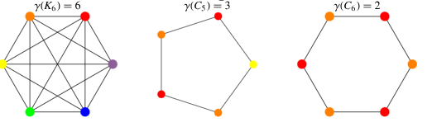
Chromatic Number
Scheduling Jobs
The chromatic number of a graph is the smallest number of colours needed to colour the vertices so that no two adjacent vertices share the same colour.
Vertices of the same colour could represent jobs that can be scheduled simultaneously.

Slide 39
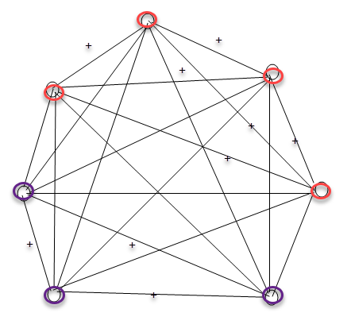
A Balanced Graph
21 edges, 9 of which are positive.
6 positive edges join 4 people (or groups) who all get on together.
3 positive edges join 3 people (or groups) who all get on together. If one of these 3 edges turned negative we would have an unbalanced graph – an ‘eternal triangle’ of 3 people (or groups) who cannot get on together.

Slide 40
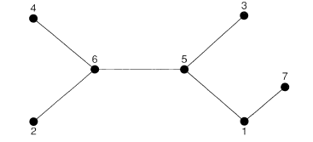
A code for every labelled tree
There are 2^{(n -2)} labelled trees
Remove the lowest end vertex (2) and start the sequence with the label of the adjacent vertex (6)
Repeat: Remove the lowest remaining end label (3), so the sequence becomes 65.
Repeat: Remove the lowest end label 4, so the sequence becomes 656.
Repeat: Remove the lowest end label 5, so the sequence becomes 6565.
Repeat: Remove 5, so the sequence becomes 65651.

Slide 41
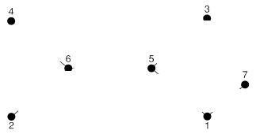
A labelled tree for every code
There are 2^{(n -2)} labelled trees
From sequence 65651 and vertices 1, 2, 3, 4, 5, 6, 7.
The smallest number NOT in both lists is 2, so reduce both lists and Join vertices 6 and 2.
Repeat: Join vertices 5 and 3
Repeat: Join vertices 6 and 4
Repeat: Join vertices 5 and 6
Repeat: Join vertices 1 and 45
Join the remaining vertices 1 and 7

Slide 42
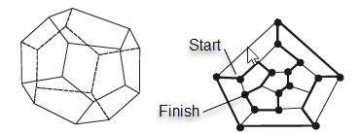
Hamilton’s Icosian Game
Every one of the 20 vertices of the icosahedron has degree 3.
Hamilton’s ‘Icosian Game’ of 1857 was a puzzle to find a path through all 20 vertices without repetition.

Slide 43
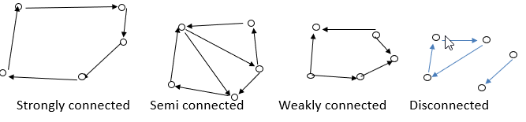
‘Connectedness’
Undirected Graphs are either connected or disconnected.
Connected Directed Graphs are either:-
weakly connected – i.e. connected with direction disregarded.
or semi connected - a directed path in one or other direction between every pair of vertices
or strongly connected – directed paths between all pairs of vertices

